Slide 1
Regression :-
Prediction of Store Sales

Slide 2
Problem Statement:- To build a model to predict the sales of the store
Dataset:-
Shape:-(14204,12)…(row, columns)
Target Column:-Item Outlet Sales
Target Column:-Describe
Count=8523
Mean=2181.288
Std=1706.499
Min=33.29
Max=13086.96
25%=834.247
50%=1794.331
75%=3101.296

Slide 3
Treatment on the dataset:-
There were 5681 missing values in the Item_Outlet_Sales.
Rows with the missing values are dropped, since by imputing the model performance was very low.
Columns like :- Item Fat Content, Item Type, Outlet Size, Outlet Location Type, Outlet Type were label encoded to convert them from object to numeric.
The whole dataset is scaled by using a Standardization method to bring the whole dataset to a common scale.

Slide 4
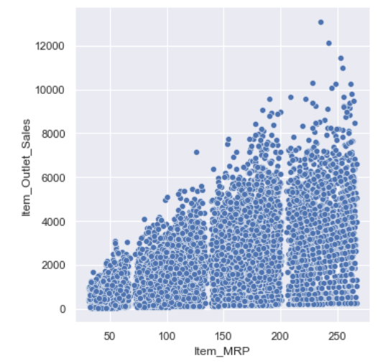
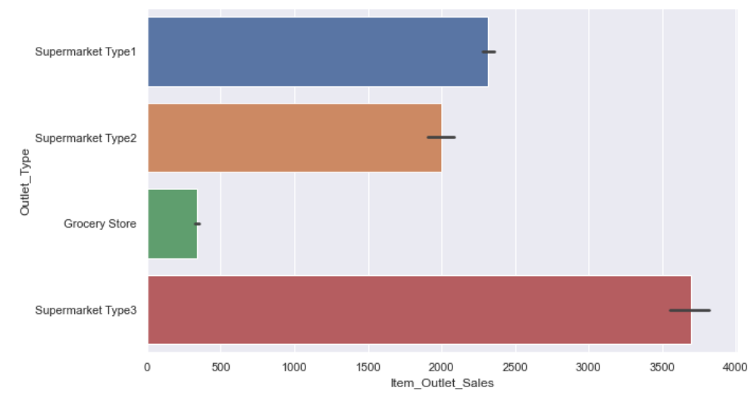
Data Visualization:-
As the MRP of the item increases ,sales also increases
Sales is less for the grocery store compared to the supermarket

Slide 5
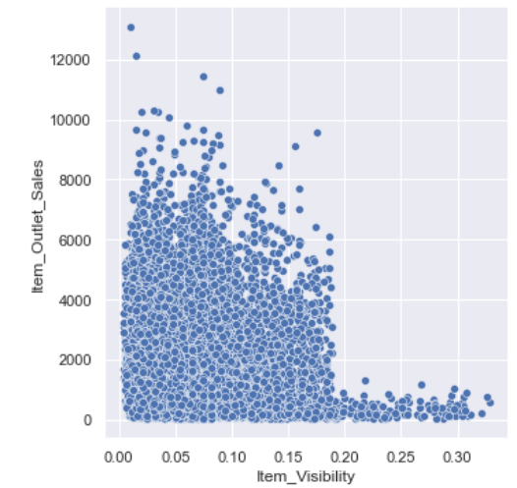
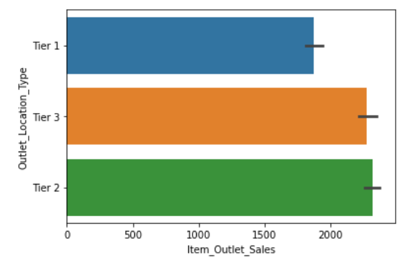
Data Visualization:-
Item visibility is inversely proportional to sales.
Location has a a very low impact on the sales

Slide 6
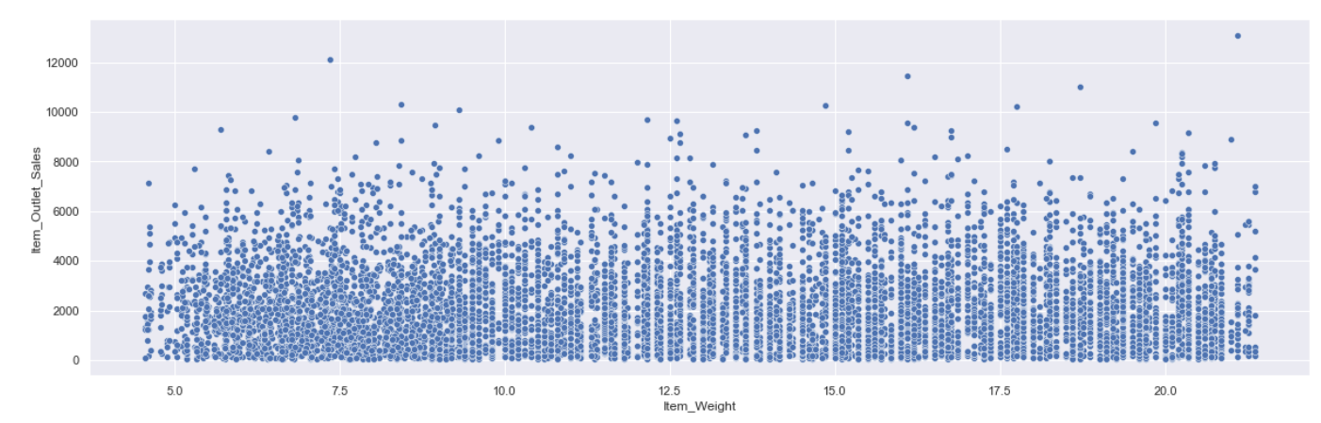
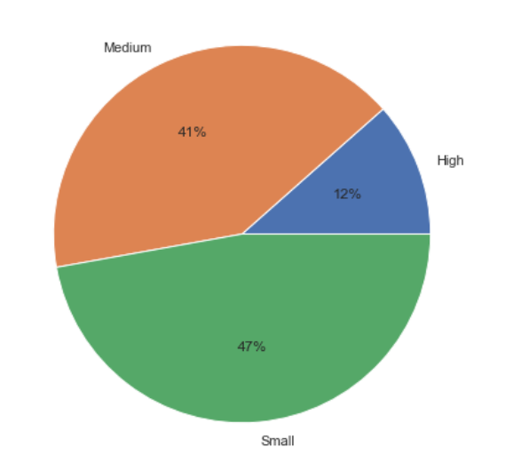
Data Visualization:-
The sum of the sales is high for small and medium stores.
The item weight doesn’t have any impact on the sales

Slide 7
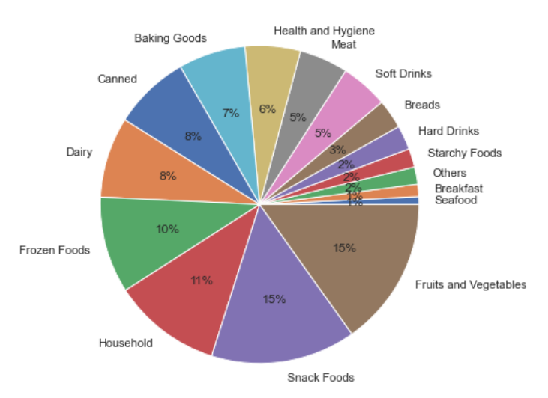
Data Visualization:-
The sales is high for the item such as fruits and vegetable and snacks food.

Slide 8
Feature Selection:-
Columns have been selected on the basis of highly correlated with the Item Sales.
1-Item MRP.
2-Item Visibility.
3-Outlet Type
4-Outlet Size

Slide 9
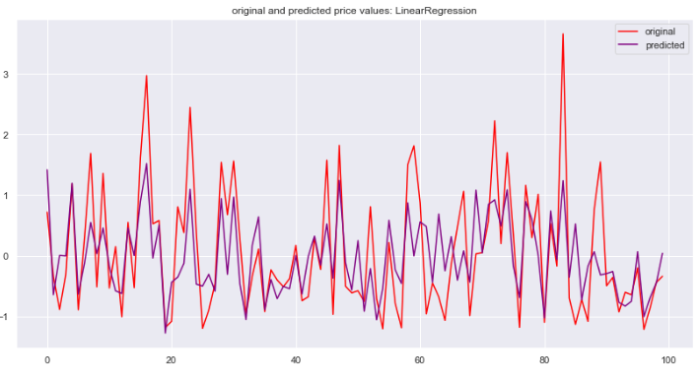
Linear Regression
1-Score on train data:-49.29%
2-Score on test data:-48.24%
3-CV score:-51.06%
4-RMSE :-0.7

Slide 10
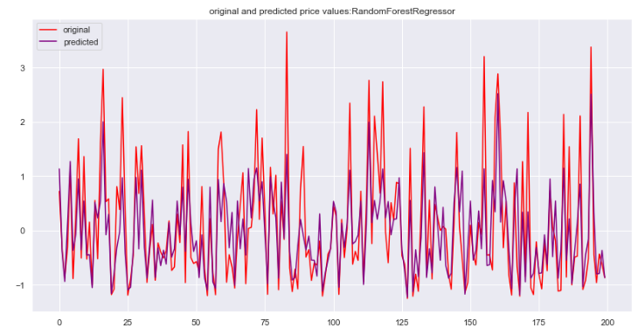
Random Forest Regressor
1-Score on train data:-61.62%
2-Score on test data:-58.83%
3-CV score:-40.20%
4-RMSE :-0.63

Slide 11
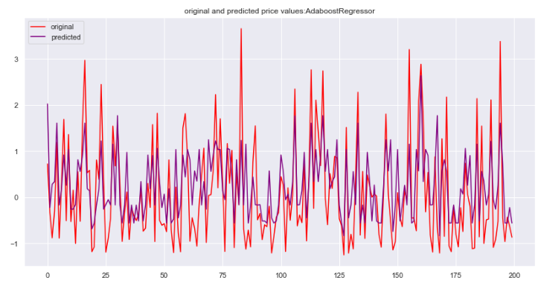
Adaboost Regressor
1-Score on train data:-48.04%
2-Score on test data:-44.42%
3-CV score:-57.85%
4-RMSE :-0.74

Slide 12
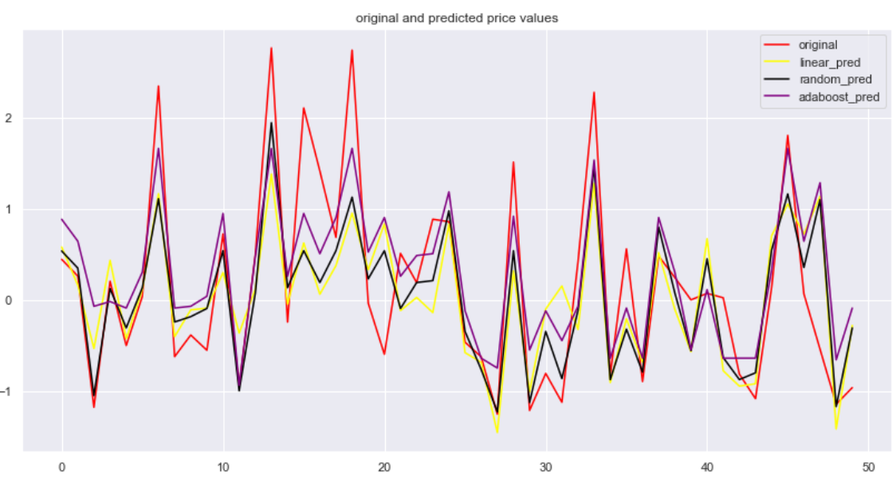
Prediction of various model:-

Slide 13
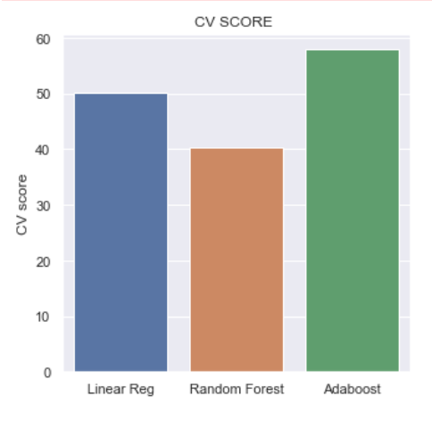
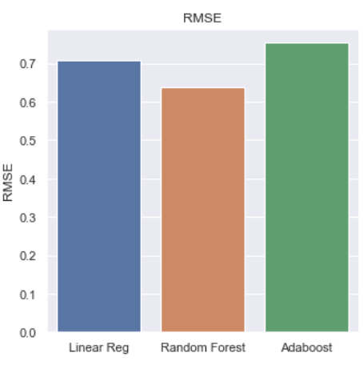
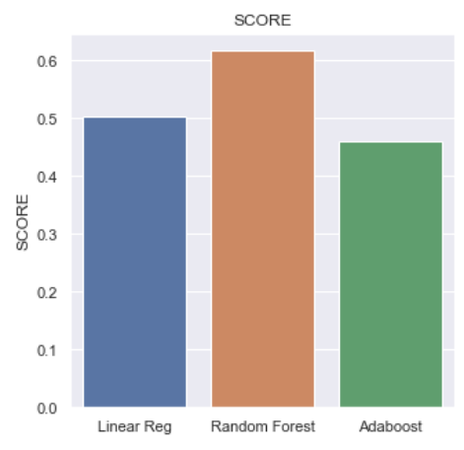
Final Conclusion:-
On the basis of rmse and the score ,Random Forest Regressor is the best model.

